Slide 1
Automated non-invasive screening of Anemia for remote diagnosis
Student – Shrey Gupta Supervisor (KCDH) – Dr Nirmal Punjabi, Prof. Ganesh Ramakrishnan
Supervisor (Intelehealth) – Ms. Priya Joshi

Slide 2
Background
Anemia is a medical condition characterized by a deficiency of red blood cells or a decreased ability of red blood cells to carry oxygen to the body's tissues.
Red blood cells contain a protein called hemoglobin, which binds to oxygen in the lungs and transports it to various parts of the body. When the number of red blood cells or the hemoglobin content is below normal levels, it can result in anemia.
There are several types and causes of anemia, including:
Iron-deficiency anemia: This occurs when there is a lack of iron in the body, leading to decreased production of hemoglobin.
Vitamin deficiency anemia: Deficiencies in vitamins such as vitamin B12 and folate can impair the production of red blood cells.
Hemolytic anemia: In this type of anemia, red blood cells are destroyed faster than they can be produced. It can be inherited or acquired due to various factors, including autoimmune diseases, infections, or certain medications.
Aplastic anemia: This is a rare condition where the bone marrow fails to produce enough red blood cells, white blood cells, and platelets.
Sickle cell anemia: This is a genetic disorder in which red blood cells are abnormally shaped, leading to their premature destruction and causing chronic anemia.
The most common type of anemia worldwide is iron-deficiency anemia.

Slide 3
Diagnosis and Symptoms
Diagnosing anemia requires a comprehensive evaluation that typically involves a medical history review (to check for underlying medical conditions, previous surgeries, medications, and dietary habits), physical examination ( to check for signs of anemia, such as pale skin, rapid heartbeat, or abnormal heart sounds), and laboratory tests (Blood tests and Bone marrow tests).
The complete blood count (CBC) is one of the most common blood tests. It measures the number of red blood cells, white blood cells, and platelets in our blood. It also provides information about the size and hemoglobin content of the red blood cells.
The symptoms of anemia can vary depending on the underlying cause, the severity of the condition, and individual factors. Some common symptoms of anemia include:
Fatigue and weakness, Pale skin, Shortness of breath, Rapid heartbeat, Dizziness, Headaches, Chest pain, Brittle nails and hair loss, etc.
Note:- These symptoms can also be indicative of other health conditions, and experiencing these symptoms alone does not confirm the presence of anemia.

Slide 4
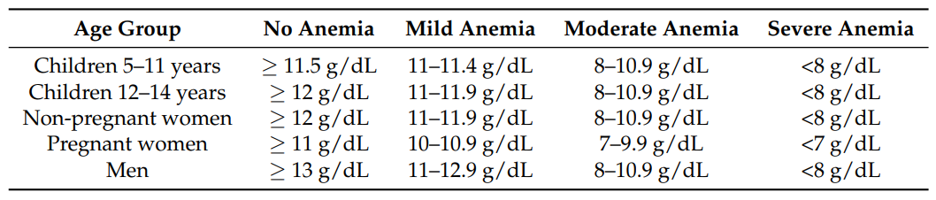
World Health Organization guidelines
Hemoglobin (Hb) thresholds used to define anemia living at sea level according to the World Health Organization guidelines

Slide 5
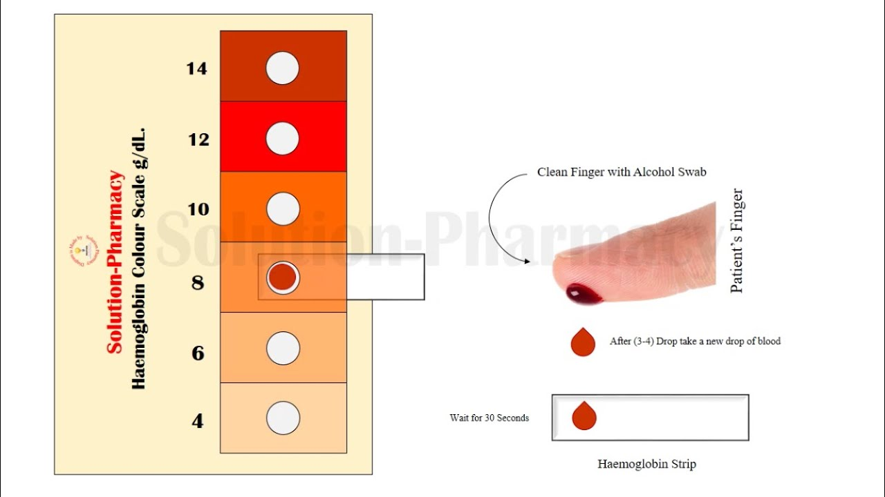
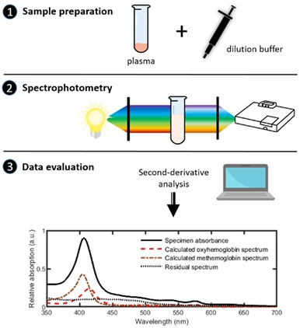
Other Methods of Anemia Diagnosis
Measuring Hemoglobin levels using Spectrophotometry
Hemoglobin color scale (HCS)

Slide 6
Objective
One of the most common symptoms of anemia is pale or yellowish skin, which might be more obvious on white skin than on black or brown skin. The natural color of sclera of eye is white, that of human nail is mauve and the palpebral conjunctiva appears pink.
The discoloration of sclera or the skin under palpebral conjunctiva/nail can act as sign of iron deficiency which is the most common cause of anemia worldwide. Most common causes of discoloured nails typically include: Nail polish, Nicotine from cigarette smoking, Hair-colouring agents, Certain infections, Injury to the nail bed, etc. Therefore discoloration of the color of human nail might not indicate the presence of anemia.
Thus studying the color of sclera or conjunctiva could help in the diagnosis of anemia. Also, palpebral conjunctiva has a highly vascular area characterized by several capillaries, so it a good spot to diagnose anemia.

Slide 7
Purpose
Anemia, characterized by low blood hemoglobin level, affects about 25% of the world’s population with the heaviest burden borne by women and children. Anemia leads to impaired cognitive development in children, as well as high morbidity and early mortality among sufferers.
Effective treatments are available for anemia upon early detection and the treatment method is highly dependent on the cause of anemia. There is a need for point-of-care (POC) screening, early diagnosis, and monitoring of anemia, which is currently not widely accessible due to technical challenges and cost, especially in low- and middle-income countries where anemia is most prevalent. Thus the World Health Organisation (WHO) has declared anemia as a public health priority and has listed anemia testing in the essential list of in vitro diagnostics.
Non-invasive technologies have obvious advantage of avoiding discomfort associated with blood sampling, eliminating biohazardous specimen handling, and enabling real-time Hb level monitoring. These technologies have the potential to facilitate universal diagnosis and screening in low-resource settings. Smart and cautious utilization and widespread application of these technologies may revolutionize anemia diagnosis and screening in resource-limited settings and dramatically decrease early mortality due to anemia.

